Slide 1

Introduction to GIS
Geographic Information Science
SADL
KU Leuven

Slide 2
Table of content
What is GIS?
Definition and properties
GIS vs CAD
Spatial reference system
Analysis
Hands-on

Slide 3
Learning objectives
At the end of the course the participants should be able:
To explain what GIS is.
To describe different datatypes
Should be able to give examples of layer
Should be able to load a layer into a GIS and style it.

Slide 4
What is GIS?
1

Slide 5
GIS
Is an abbreviation of:
G – Geographic
I – Information
S - System
- Science
In the context of this training we will use System.

Slide 6


Geographic Information System
Definitions
USGS (United States Geological Survey):
“is a computer system capable of capturing, storing, analyzing, and displaying geographically referenced information; that is, data identified according to location. Practitioners also define a GIS as including the procedures, operating personnel, and spatial data that go into the system."
ESRI:
"is a computer-based tool for mapping and analyzing things that exist and events that happen on earth. GIS technology integrates common database operations such as query and statistical analysis with the unique visualization and geographic analysis benefits offered by maps.“
The spatial (geographic) part differentiates a GIS from a standard computer database.

Slide 7





GIS components
A GIS consists of five key components
hardware
software
data
people
methods

Slide 8
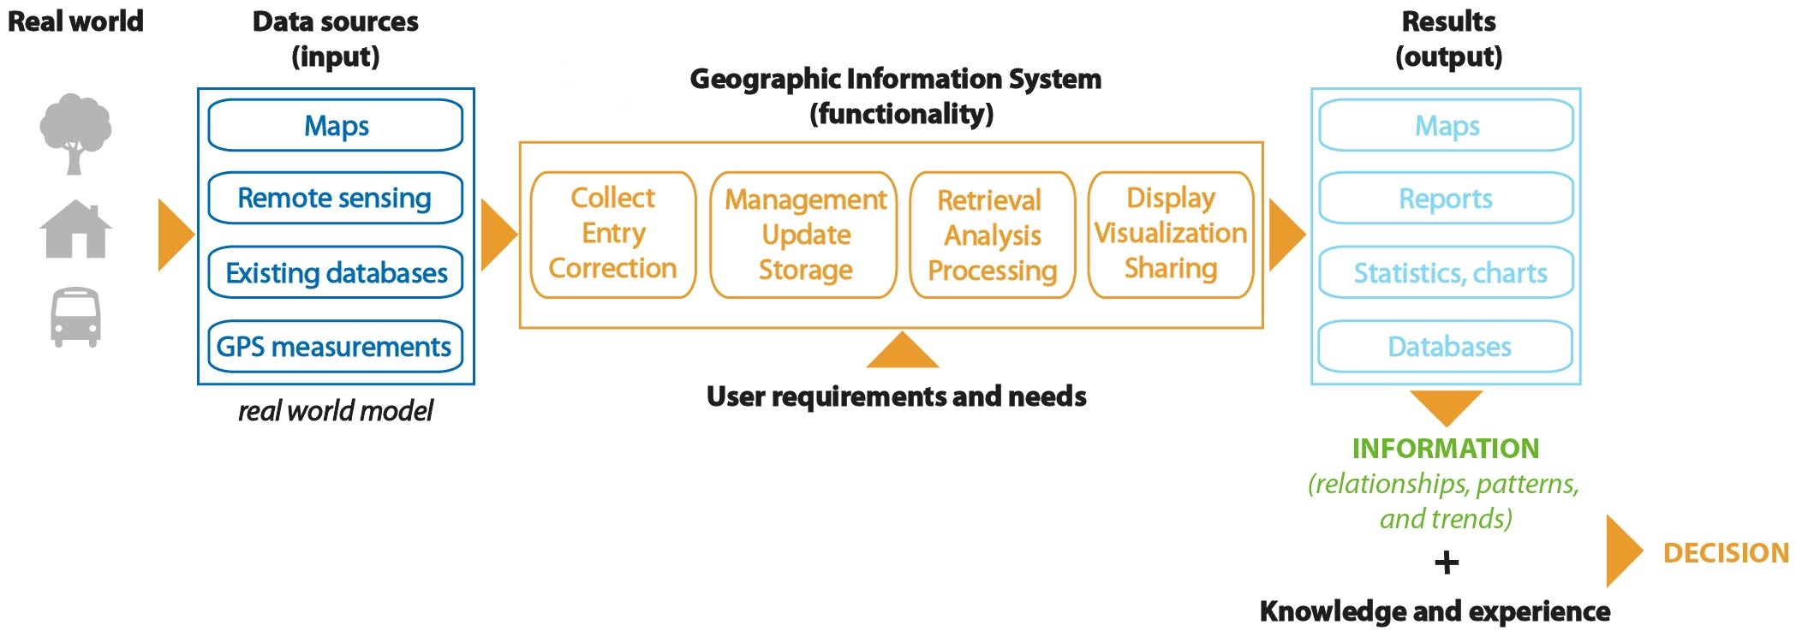
Main idea of GIS
The main goal of GIS is to provide spatial information to decision makers.

Slide 9
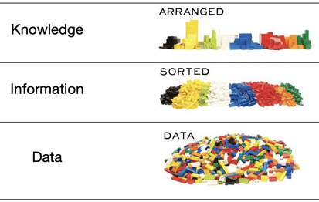
Data vs Information
Data:
means simply facts or figures - pieces of information, but not information itself
collected and stored in databases.
When data are processed, interpreted, organized, structured or presented so as to make them meaningful or useful, they are called information. Information provides context for data.
→ In a GIS, spatial analysis and modelling are the main source of information.
Spatial analysis - a set of methods and tools for performing operations on spatial data in order to obtain additional information.
Versatile, n.d.
Notes:
Versatile. (n.d.). Three DIK pics. Versatile. https://www.versatile.pub/blog/three-dik-pics

Slide 10








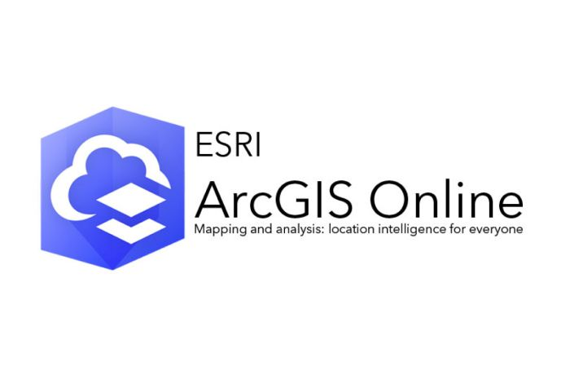






Software
Geospatial software and tools:
Desktop GIS
GIS as a service
Spatial database management systems
Map servers

Slide 11
Fields use of GIS
urban planning
environment protection and management
land use monitoring
Agriculture
transportation/logistics
emergency management
network infrastructure management
Tourism
...

Slide 12
Advantages
Ability to view, visualize and interpret data in the form of maps, charts and reports - relationhips and trends easy to see and understand
Improved decision making and problems solving through specific and detailed information regarding locations of features and phenomena
Reduce costs and increase efficiency
Improved communication between organisations or departments

Slide 13
Definition and properties
2

Slide 14
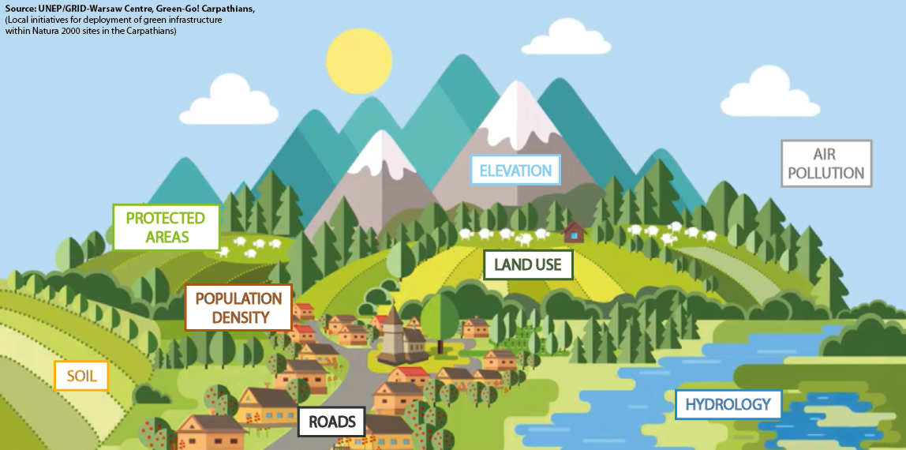

Real world to GIS

Slide 15
Spatial data
Definition
Spatial object means an abstract representation of a real-world phenomenon related to a specific location or geographical area.
Spatial data means any data with a direct or indirect reference to a specific location or geographical area.
Spatial data set means an identifiable collection of spatial data.
DIRECTIVE 2007/2/EC of the European Parliament ad of the Council of 14 March 2007 establishing an Infrastructure for Spatial Information in the European Community (INSPIRE)

Slide 16
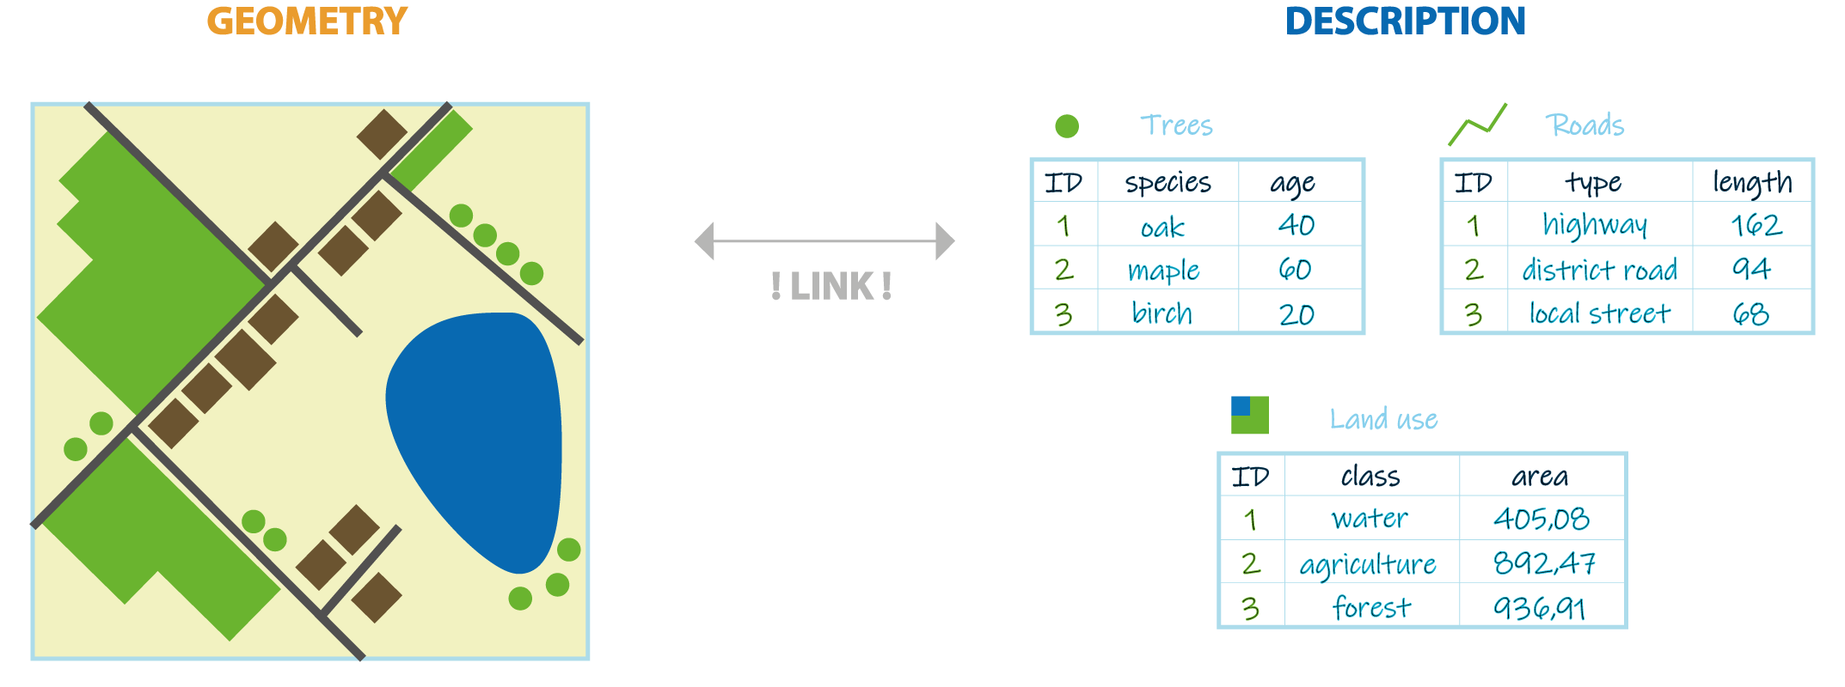
Spatial data
Properties
Spatial data describes shape, location, spatial relationships and attributes of features related to the Earth's surface.

Slide 17
Data model
Data model is a set of guidelines to convert the real world (called entity) to the digitally and logically represented spatial objects consisting of the attributes and geometry.
The attributes are managed by thematic or semantic structure while the geometry is represented by geometric-topological structure.
Shunji, 1999

Slide 18


Spatial data representation model
2 common spatial data models
Vector
Raster

Slide 19
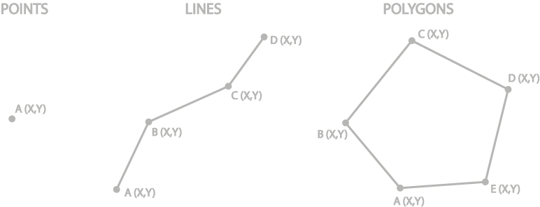
Vector
Geometry types
A vector data model defines discrete objects such as fire hydrants, rivers, lakes.
A vector data models divided into three basic types:
All three of these types of vector data are composed of coordinates and attributes attached to the geometry.

Slide 20
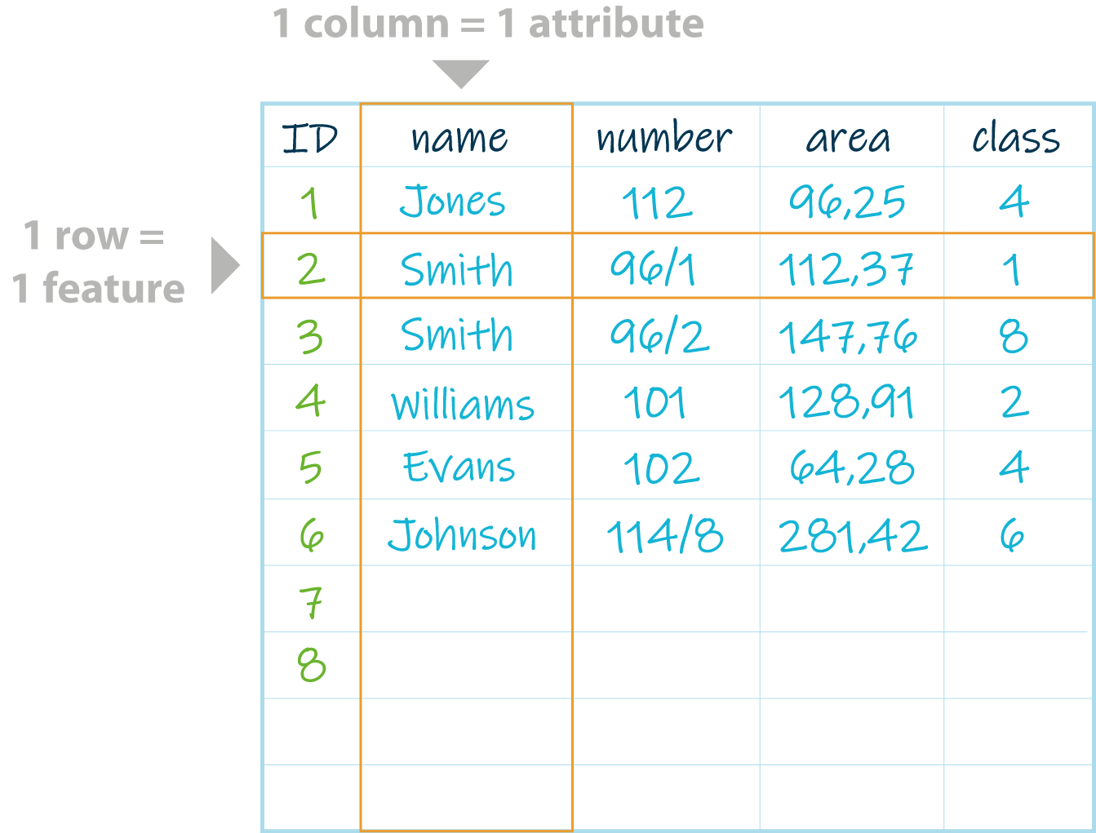
Vector
Attribute table
a nonspatial information about a geographic feature in a GIS
usually stored in a table
linked to the feature by a unique identifier (ID)
A database or tabular file containing information about a set of geographic features, usually arranged so that:
each row represents a feature
each column represents one feature attribute.
The attribute values can be used to find, query, analyze and symbolize features.

Slide 21
Vector
File Formats
ESRI Shapefile - the most common geospatial file type developed by ESRI, consists of:
shp (feature geometry)
shx (shape index position)
dbf (attribute data)
prj (projection system metadata)
xml (associated metadata)
GML (Geography Markup Language) - XML based open standard for GIS data exchange
KML/KMZ (Google Keyhole Markup Language) - XML based open standard for GIS data exchange
GPX (GPS eXchange Format) - GPS data file
GeoJSON (Geographic JavaScript Object Notation) - a lightweight format based on JSON, used by many open source GIS packages

Slide 22
Raster
Model
A raster data model defines continous data and phenomena.
Raster's are:
digital aerial photographs and satellites imagery (spectral data),
continuous data represents phenomena - e.g. temperature, precipitation, elevation, slope,
digital pictures, scanned maps and plans.

Slide 23
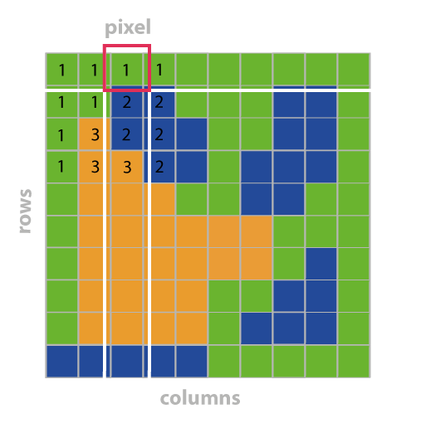
Raster
Geometry
A raster consists of:
a matrix of cells (or pixels)
organized into rows and columns (or a grid)
where each cell contains one value representing information such as temperature, elevation, or spectral data.
Pixel - smallest visible element of an image.
Grid - 2-D object feature that represents a single element of a continous surface.

Slide 24
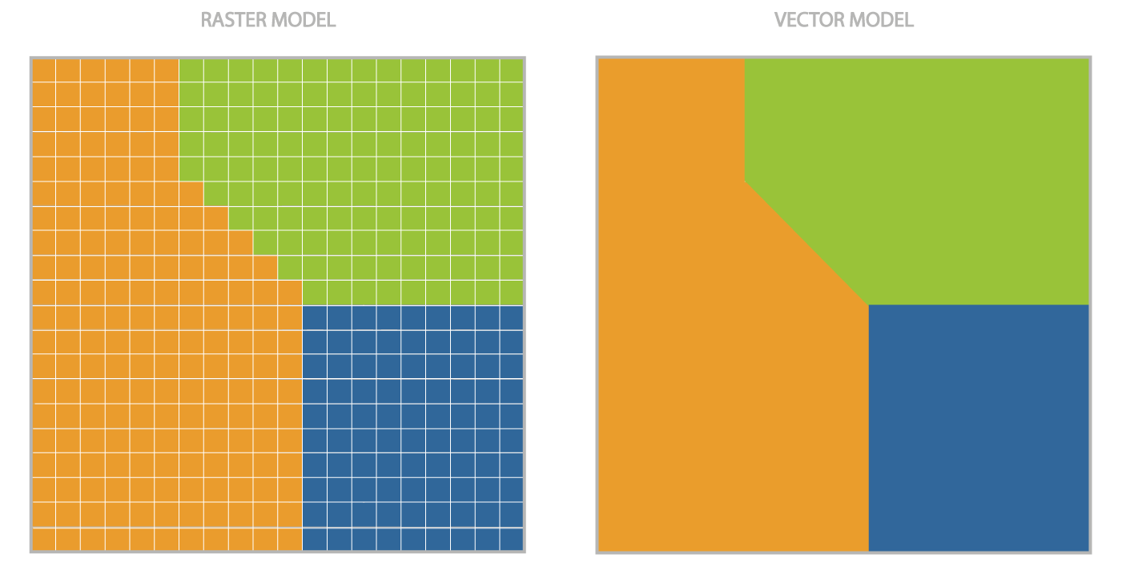
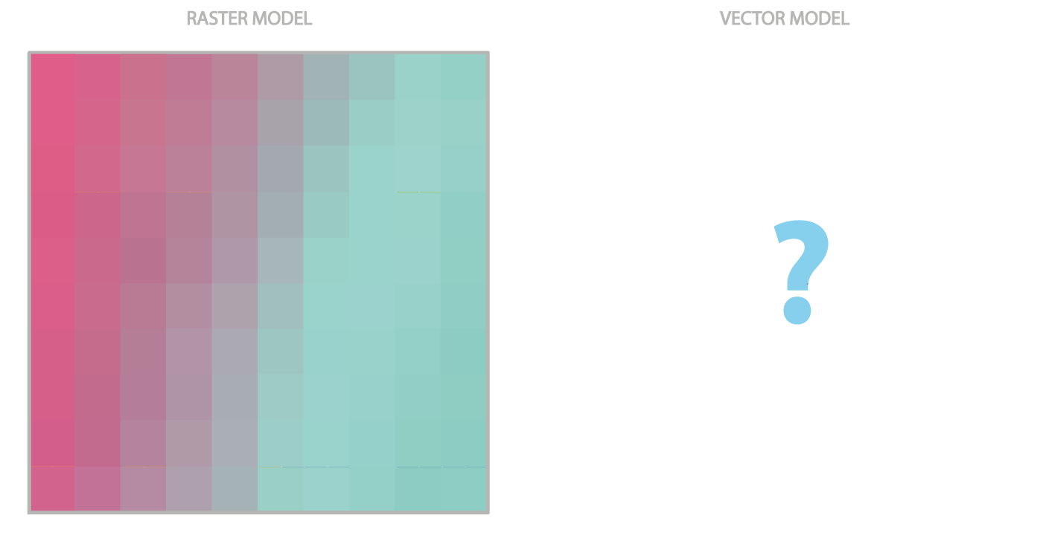
Raster vs Vector

Slide 25
Raster
File formats
GeoTIFF - TIFF variant enriched with GIS relevant metadata, may be accompanied by other files:
tfw (raster geolocation)
xml (metadata)
aux (projections and other information)
ovr (pyramid files improves performance for raster display)
IMG - ERDAS IMAGINE image file format
ESRI Grid - format developed by Esri, which has two varieties: binary or ASCII

Slide 26
GIS vs CAD
3

Slide 27
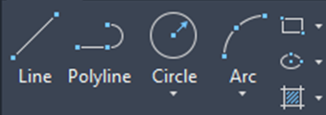
GIS & CAD
CAD GIS
Models things in real world
Coordinates are relative
No relation between objects
Basic objects:
Models the real world
Coordinates are absolute → use of coordinate system
Object have relations
Networks
Areas
connectivity, conductivity, and associativity
Objects:
point
line
polygone
MGFX, n.d.
Pima County. (2008). What’s the relationship between CAD & GIS? Pima County. https://www.pima.gov/2008/Whats-the-Relationship-Between-CAD-GIS
Notes:
MGFX. (n.d.). AutoCAD 2023: Restore ribbon by reloading customization file. MGFX. https://mgfx.co.za/blog/building-architectural-design/autocad-2023-restore-ribbon-by-reloading-customization-file/
Pima County. (2008). What’s the relationship between CAD & GIS? Pima County. https://www.pima.gov/2008/Whats-the-Relationship-Between-CAD-GIS

Slide 28
GIS & CAD
CAD GIS
point
line
polygone

Slide 29
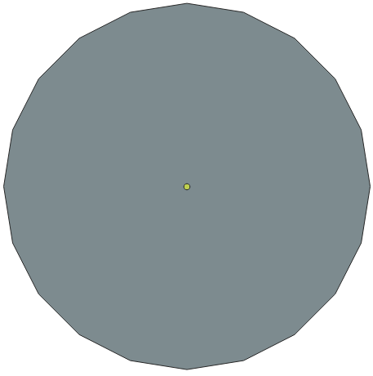
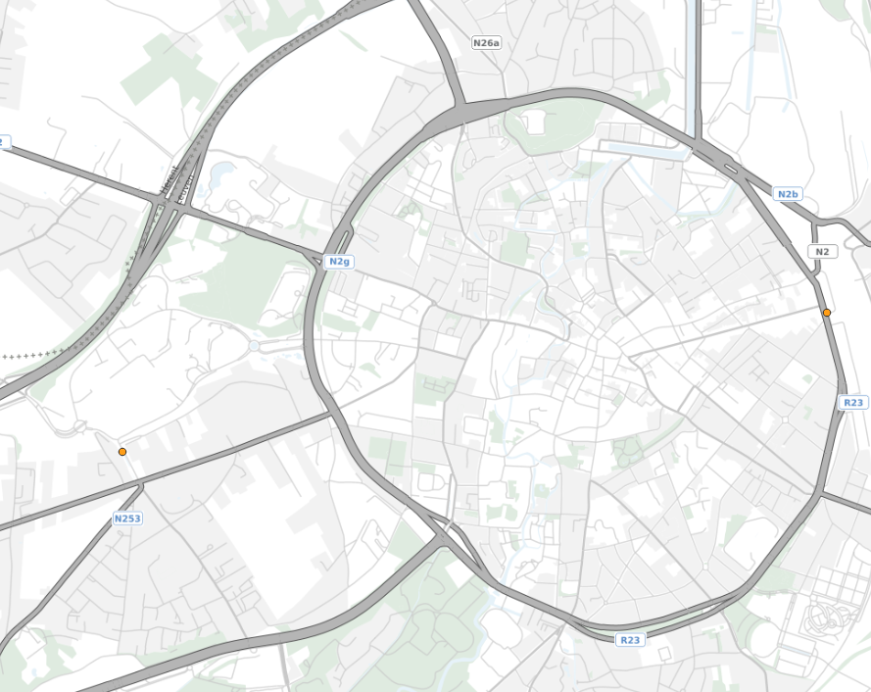
GIS: adds topology
Relationships between objects
Node topology: allows spatial analysis,
such as buffering to determine other objects within a certain range
Network topology: allows modeling of direction and resistance.
Path tracing finds the fastest or best route.
Flood tracing determines the maximum flow from a given point and network resistance.
As with node topology, buffer analysis can be applied to networks too
Polygon topology: enables polygons to have relationships. Polygons also have centroids which can be used to hold data relevant to the polygons. Polygon spatial analysis includes overlay analysis such as determining parcels in a floodplain. Polygons can be "dissolved" using attributes with common values to remove interior lines, in effect aggregating polygons with in the same class.
Notes:
Pima County. (2008). What’s the relationship between CAD & GIS? Pima County. https://www.pima.gov/2008/Whats-the-Relationship-Between-CAD-GIS

Slide 30
Spatial reference system
4

Slide 31
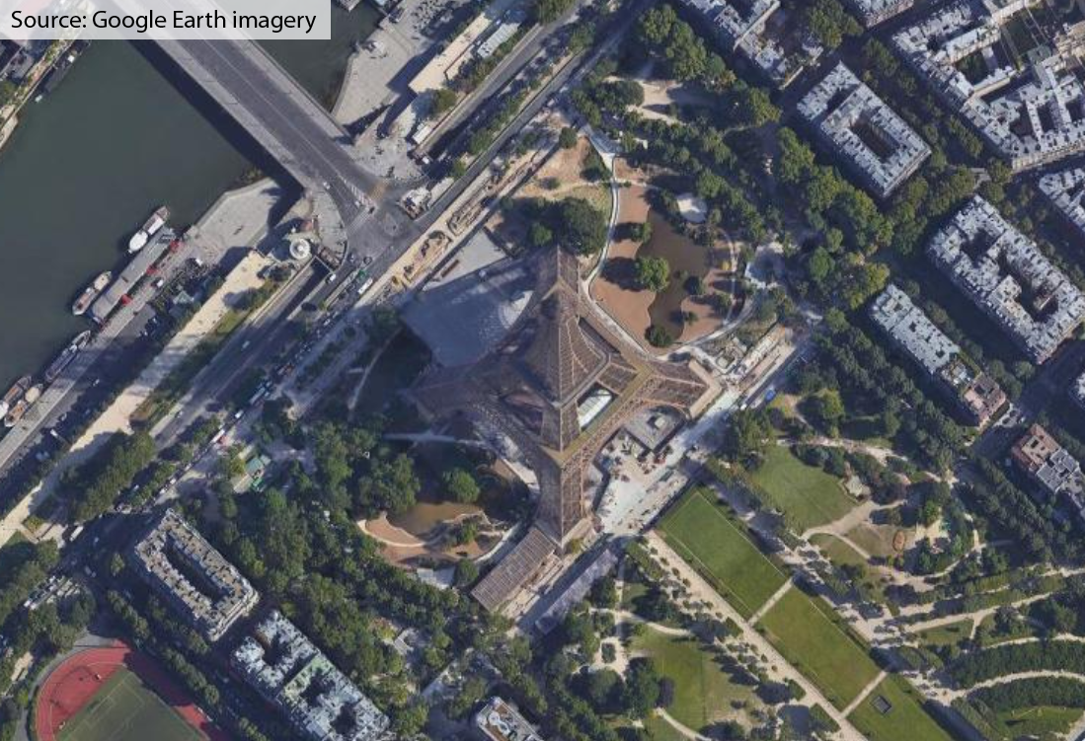
Spatial reference system
Definition
A spatial reference describes where features are located in the real world.
It is a key component of spatial data and applications and differentiates a GIS from a standard databases.
A spatial reference system (SRS) or coordinate reference system (CRS) is a coordinate-based local, regional or global system used to locate geographical entities.
Champ de Mars, 5 Avenue Anatole France, 75007 Paris, France
48° 51' 29.1348''N; 2° 17' 40.8984‘’ E (= 48.858093; 2.294694)
448256.00 m E; 5411928.00 m N

Slide 32
Spatial reference systems
2 Different types
Geographical coordinate systems (GCS):
a global or spherical coordinate system based on latitude and longitude coordinates.
Projected coordinate systems (PCS):
such as Universal Transverse Mercator (UTM), provide different ways to project maps of the Earth’s spherical surface into a two-dimensional Cartesian coordinate plane.
Coordinate systems (both geographic and projected) provide a framework for defining real-world locations.

Slide 33
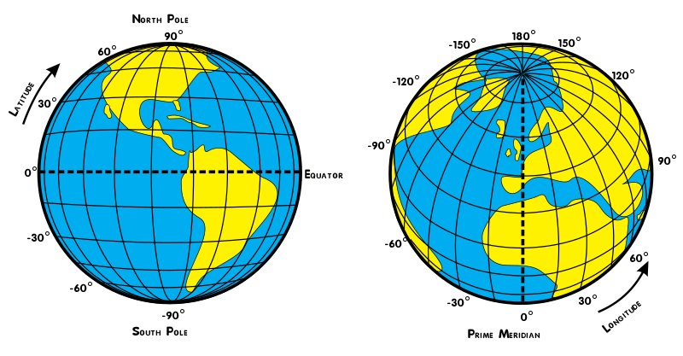
Geographic coordinate system
: reference system for identifying locations on the curved surface of the earth.
Measured in angular units from the center of the earth relative to two planes:
the plane defined by the equator
the plane defined by the prime meridian (which crosses Greenwich England)
A location is therefore defined by two values:
a latitudinal value: angle between the equatorial plane
and a line that passes through that point and is normal to the surface
a longitudinal value: angle from a reference meridian to
another meridian that passes through that point

Slide 34

Projected coordinate system
Projection: a method by which the curved surface of the Earth is portrayed on a flat surface
This requires a systematic mathematical transformation of the Earth’s graticule of lines of longitude and latitude onto a plane.
All projection types can be aggregated into three groups: planar, cylindrical and conical.
Projected coordinate system, locations are identified by:
X, Y coordinates on a grid.
Unlike a geographic coordinate system,
a projected coordinate system can be used to measure distances and areas.

Slide 35
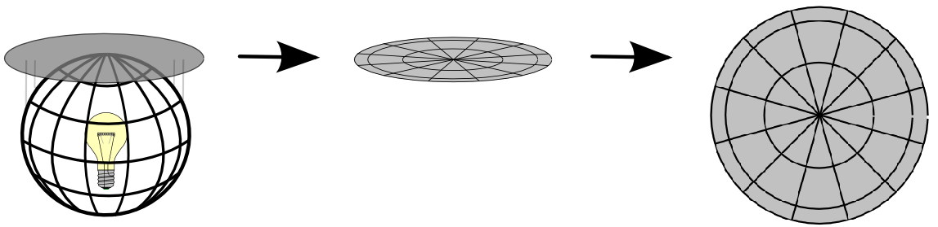
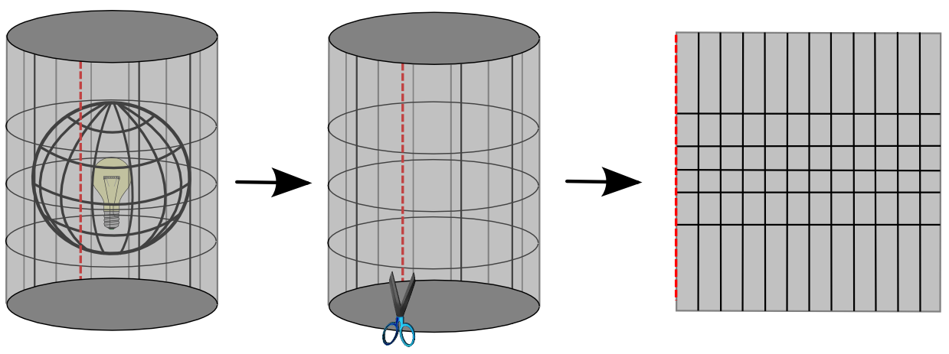
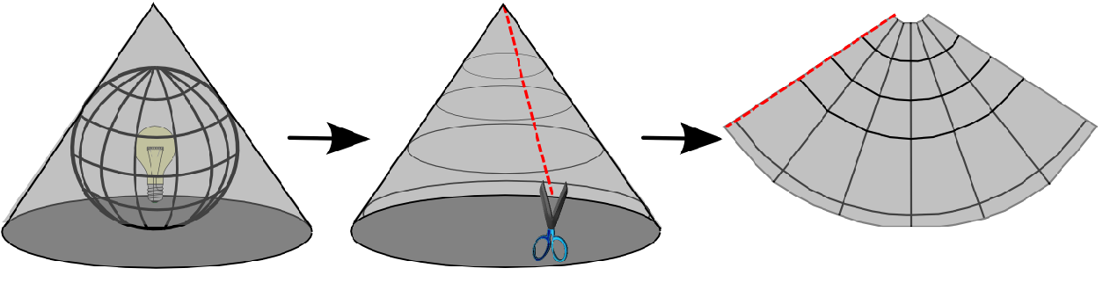
Projected coordinate system
Types of projections
Planar projection
Cylindrical projection
Conical projection

Slide 36
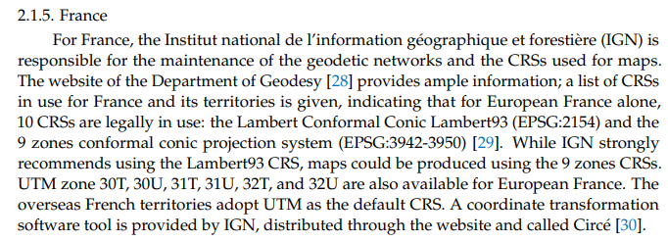
Projected coordinate system
EPSG code
EPSG codes are 4-5 digit numbers that represent coordinate reference system definitions.
GIS uses these to identify how the data must be projected or transformed
Common EPSG:
EPSG:4258 - ETRS89 (European Terrestrial Reference System 1989), geodetic coordinate system for Europe
EPSG:4326 - WGS 84, latitude/longitude coordinate system based on the Earth's center of mass, used by the Global Positioning System among others
EPSG:3857 - Web Mercator projection used for display by many web-based mapping tools, including Google Maps and OpenStreetMap
Stal, C., De Sloover, L., Verbeurgt, J., & De Wulf, A. (2022). On finding a projected coordinate reference system. Geographies, 2(2), 245-257. https://doi.org/10.3390/geographies2020017
Notes:
Stal, C., De Sloover, L., Verbeurgt, J., & De Wulf, A. (2022). On finding a projected coordinate reference system. Geographies, 2(2), 245-257. https://doi.org/10.3390/geographies2020017

Slide 37
Projected coordinate system
EPSG code
Stal et al., 2022
Notes:
Stal, C., De Sloover, L., Verbeurgt, J., & De Wulf, A. (2022). On finding a projected coordinate reference system. Geographies, 2(2), 245-257. https://doi.org/10.3390/geographies2020017

Slide 38
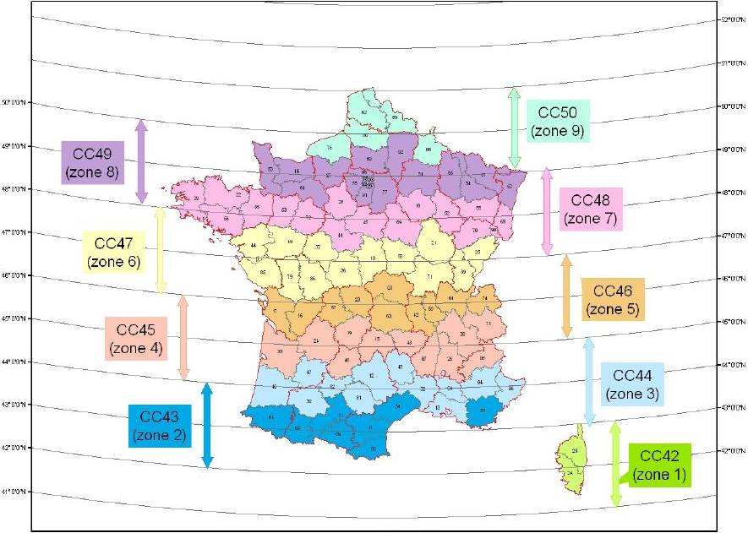
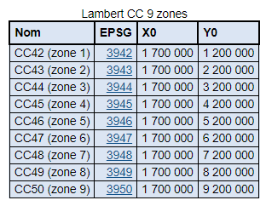
Projected coordinate system
EPSG code
Kerlom, n.d.
Notes:
Kerlom. (n.d.). Topographie: Système de projection. Kerlom. https://cad.kerlom.fr/topographie_systeme-de-projection.php

Slide 39
Analysis
5

Slide 40
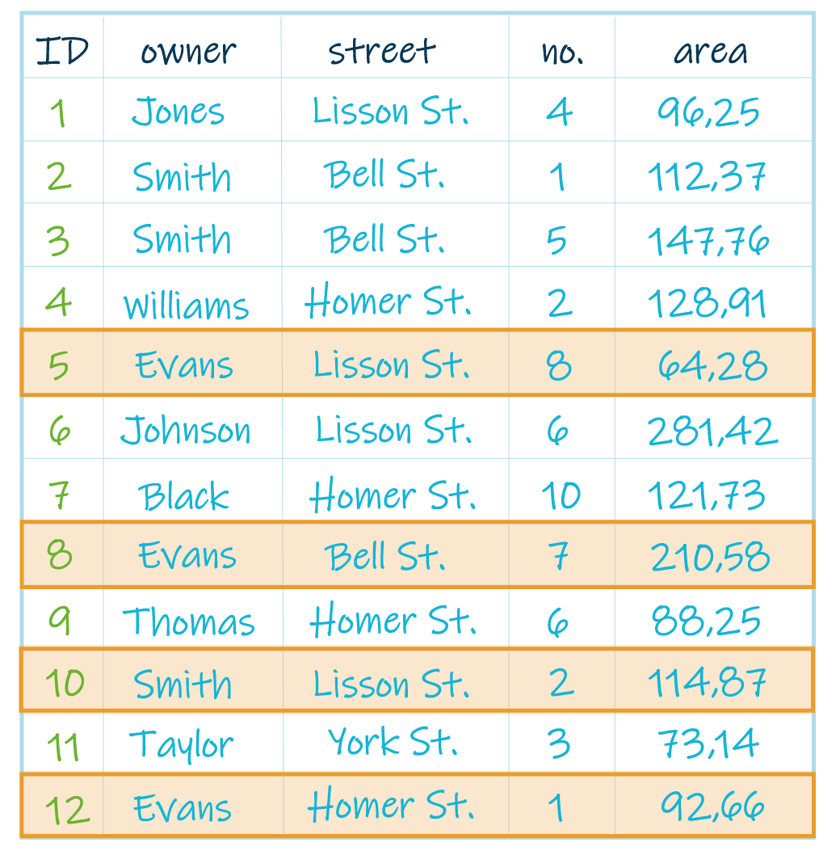
Attribute query
process of searching and retrieving records of features in a database based on desired attribute values.
"owner" = 'Evans' OR ("owner" = 'Smith' AND "street" = 'Lisson St.')

Slide 41
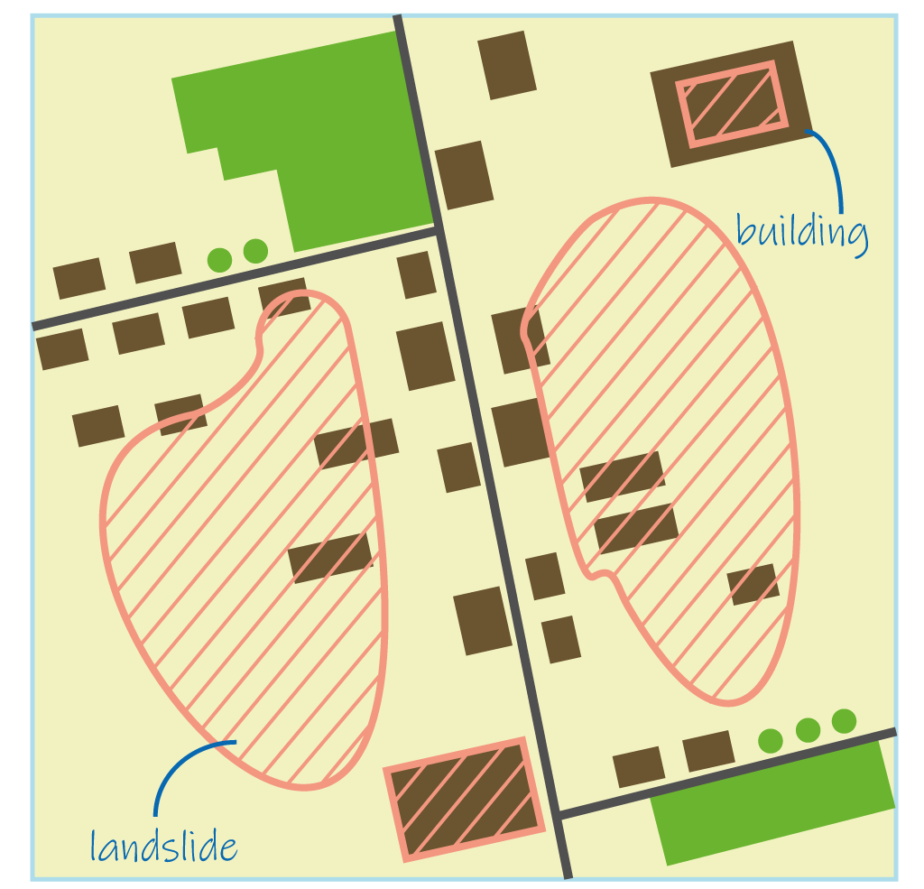
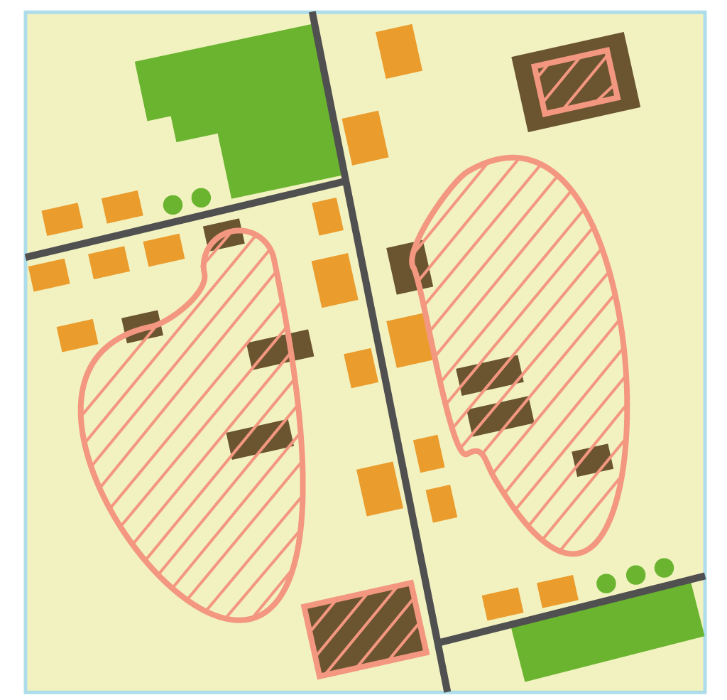
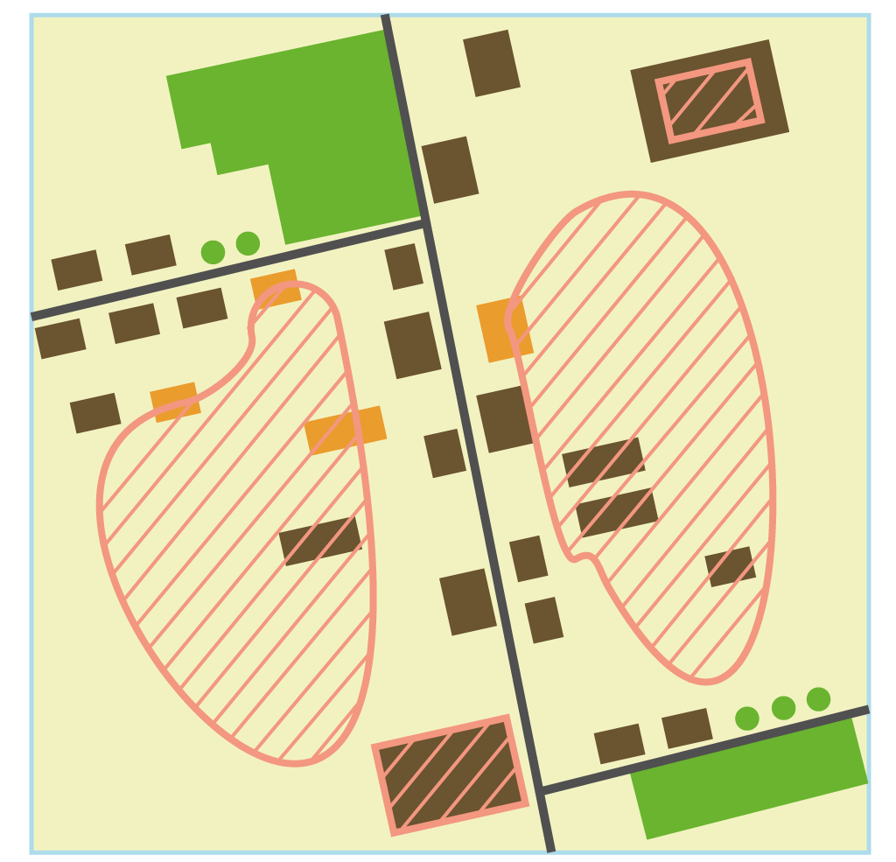
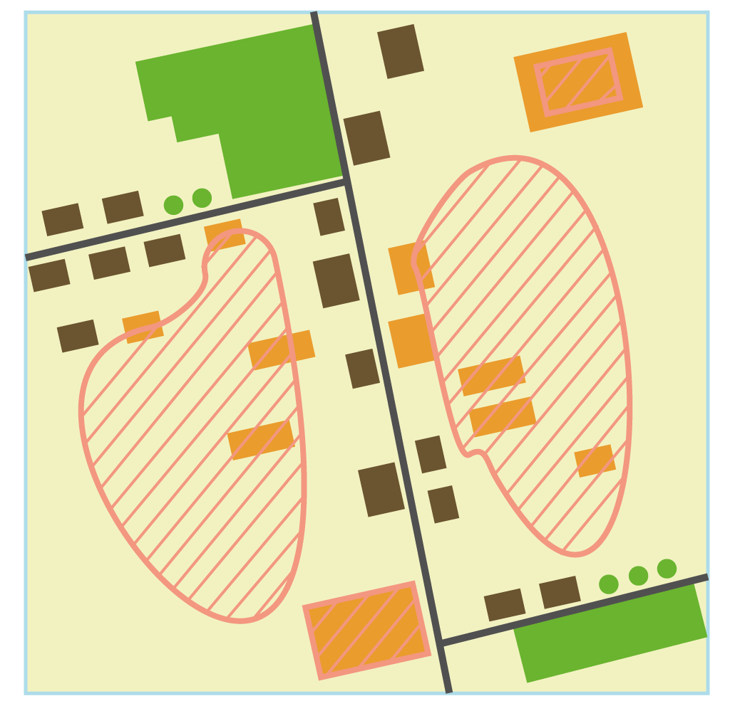
Spatial Query
process of searching and retrieving records of features in a database based on location or spatial relationship.
disjoint
overlaps
intersects

Slide 42
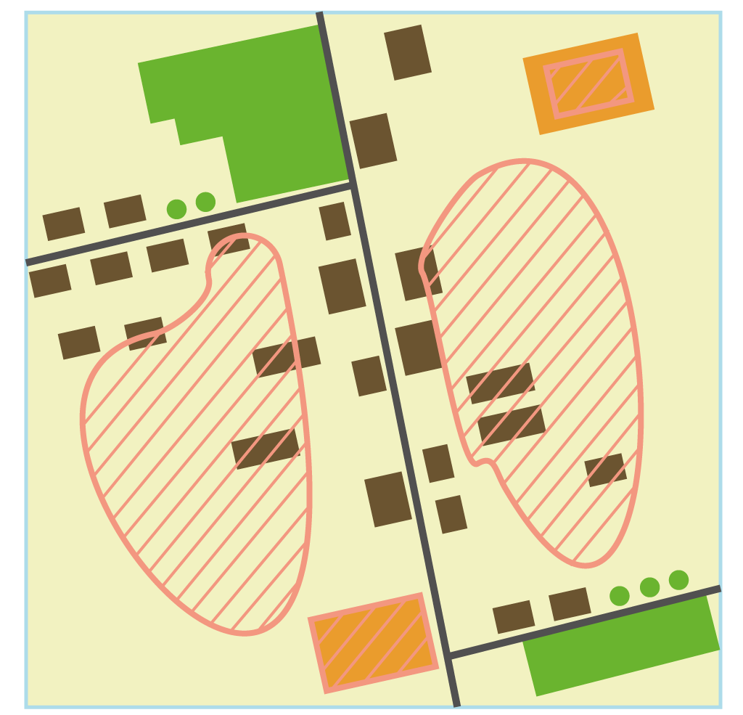
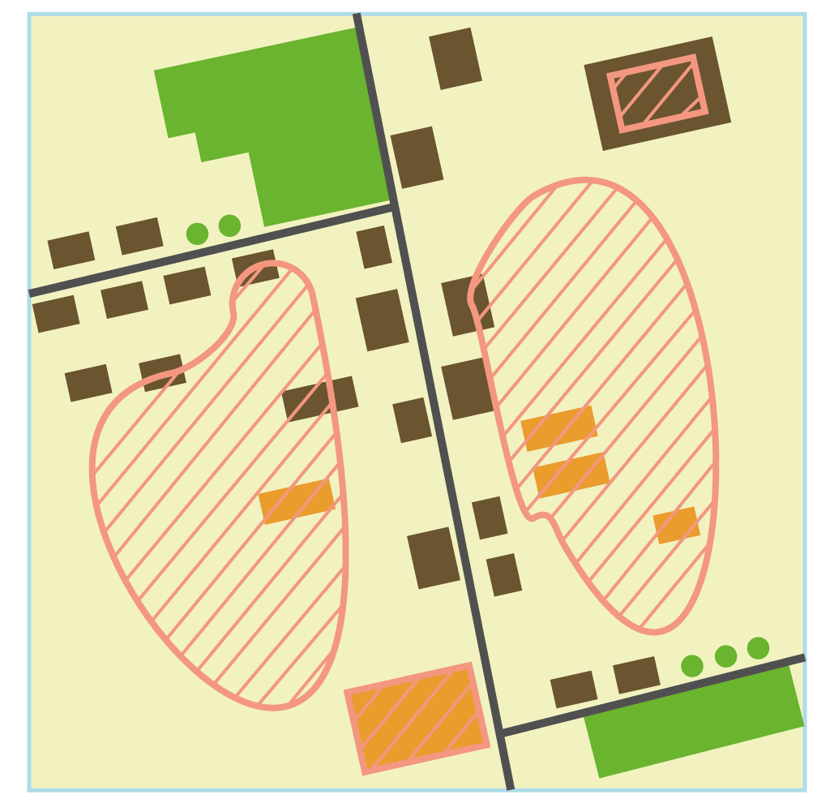
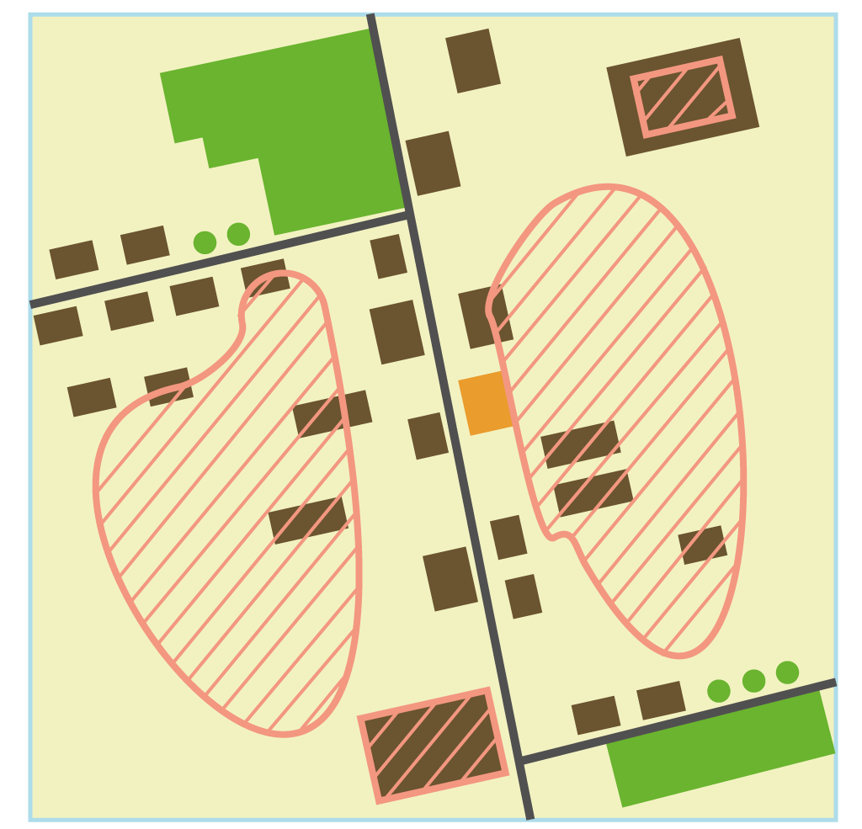
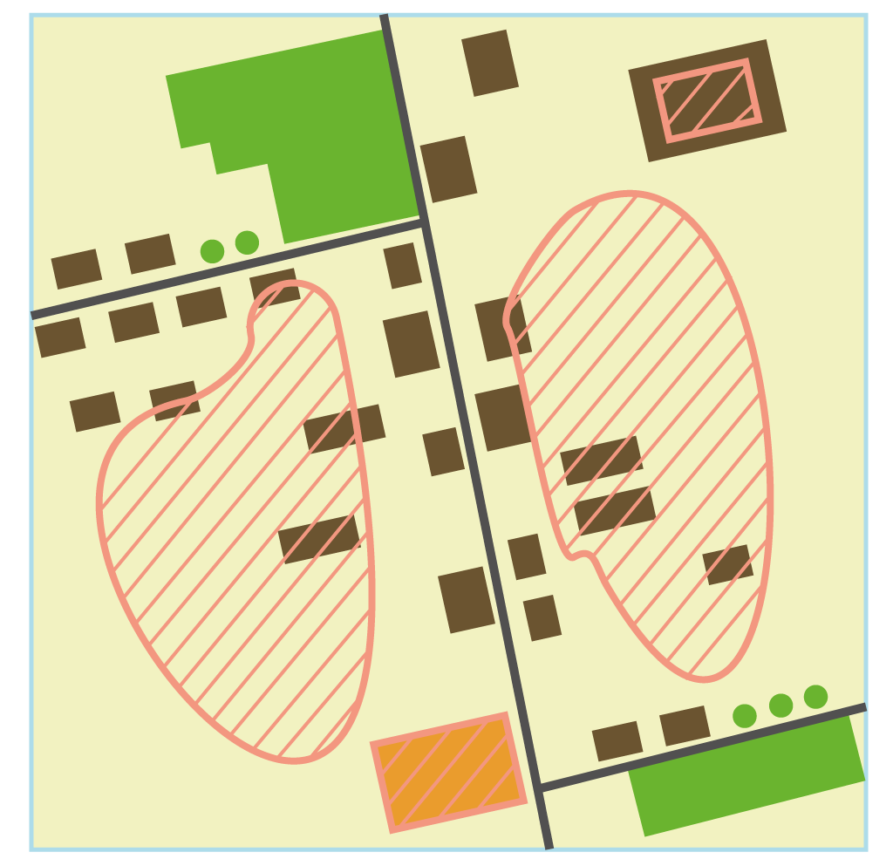
contains
within
touches
equals

Slide 43
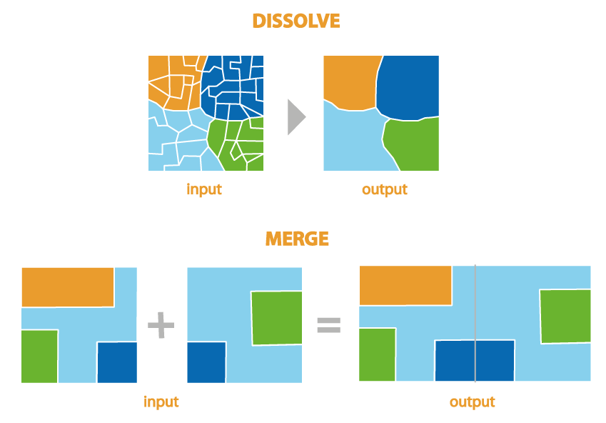
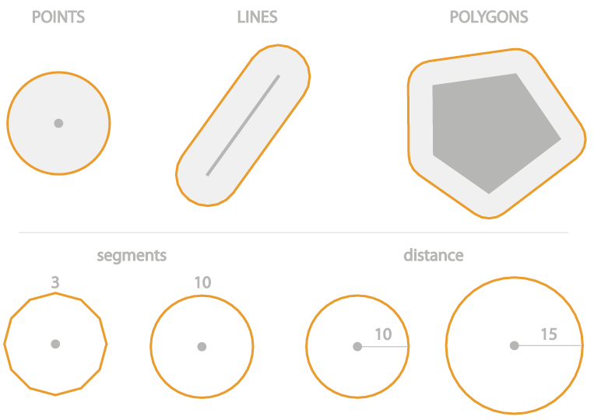
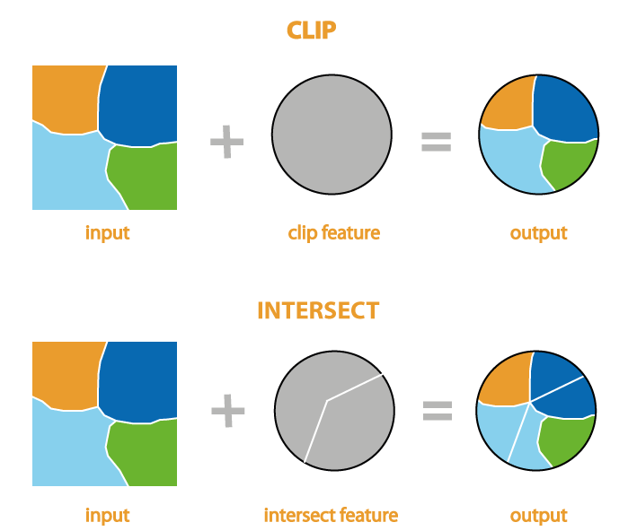
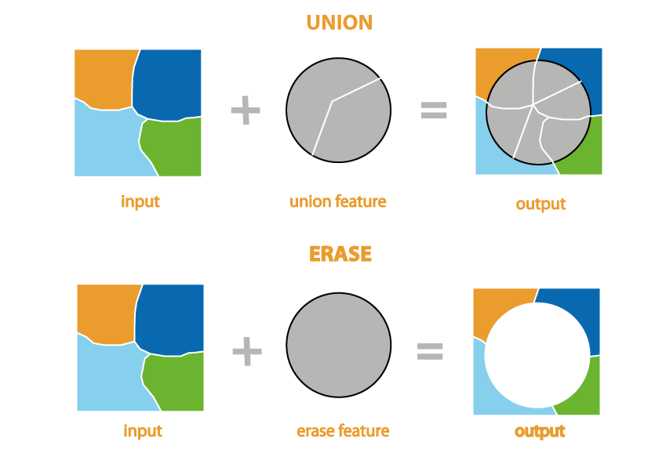
Geoprocessing
Buffer

Slide 44
Hands-on
6

Slide 45

Using QGIS
Free software
Open-source
Variety of plug-ins

Slide 46
Live tutorial
Add data layers
Change order
Change color
Show basic analysis tools

Slide 47
Some rules
Dark vs Light:
Polygons have light colours ,lines are darker and points are the darkest
Projection systems:
Use an appropriate projection system
Distinct:
Use colours and symbols that are clearly distinctable
No islands:
Your mapping area is almost never an island. So don’t map like that, extend your area.

Slide 48
Data
What | Where
World countries | Countries - Eurostat
Municipalities | Découpage administratif communal français issu d'OpenStreetMap - data.gouv.fr
road applications at the regional level | https://www.data.gouv.fr/fr/datasets/route-500/
Buildings | Télécharger la BDNB millésime 2023-11-a (format v0.7.6)
Departments | Contours des départements français issus d'OpenStreetMap - data.gouv.fr

Slide 49
Source
This course is based on EO4GEO content:
Grgic, M. (n.d.). Urban heat islands: Basic GIS knowledge, vector and raster data. EO4GEO. Designed and developed by University of Zagreb, Faculty of Geodesy. http://www.eo4geo.eu/training/urban-heat-islands-basic-gis-knowledge-vector-and-raster-data/

